Slide 1
PROJECT PROFILE
Project: | Manggahan Residences 1,2,& 3
Location: | MMDA Depot, Eastbank Road, Brgy Sta. Lucia, Pasig City
Landowner: | National Housing Authority by virtue of Pres. Proclamation No. 458
Land Area for Development: | 2,868sq.m.+7401sq.m.+7,356sq.m.=17,625 sq.m.
Project Beneficiaries: | Informal Settlers Families of Manggahan Floodway,Pasig City
Building Data | Phase 1 | Phase 2 | Phase 3
Total No. of Buildings: | 2 | 6 | 7
No. of Storeys: | 5 | 5 | 5
No. of Units/floor: | 12 | 12 | 12
No. of Units/bldg.: | 60 | 60 | 60
Total No. of Units: | 120 | 360 | 420

Slide 2
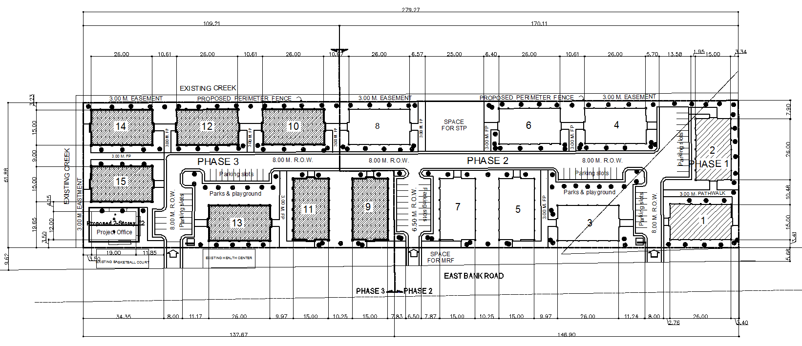
MANGGAHAN RESIDENCES 1, 2 AND 3
LEGEND:

Slide 3
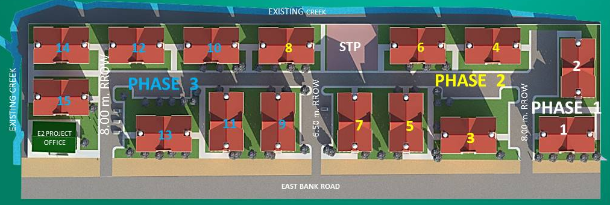
BUILDINGS’ PRESENT STATUS
PROPOSED
PROJECT
OFFICE
MASTER SITE DEVELOPMENT PLAN

Slide 4
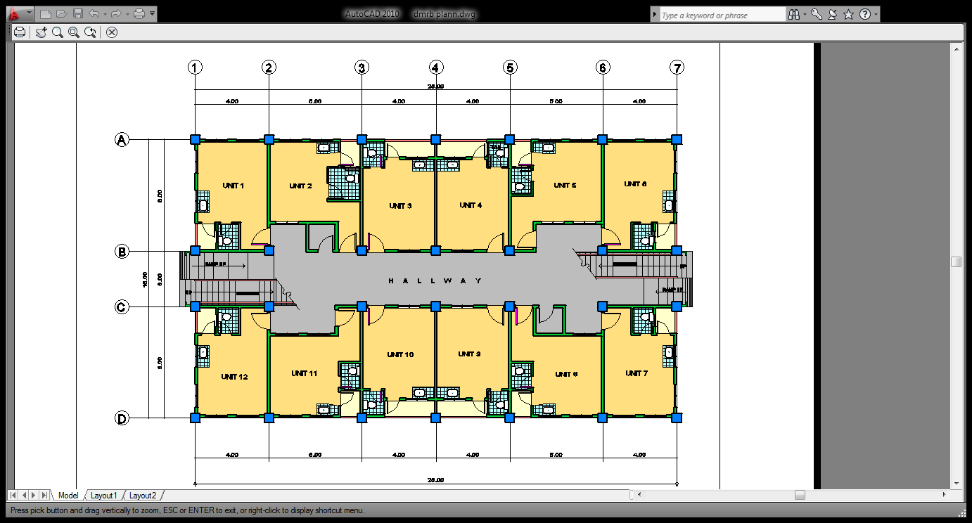
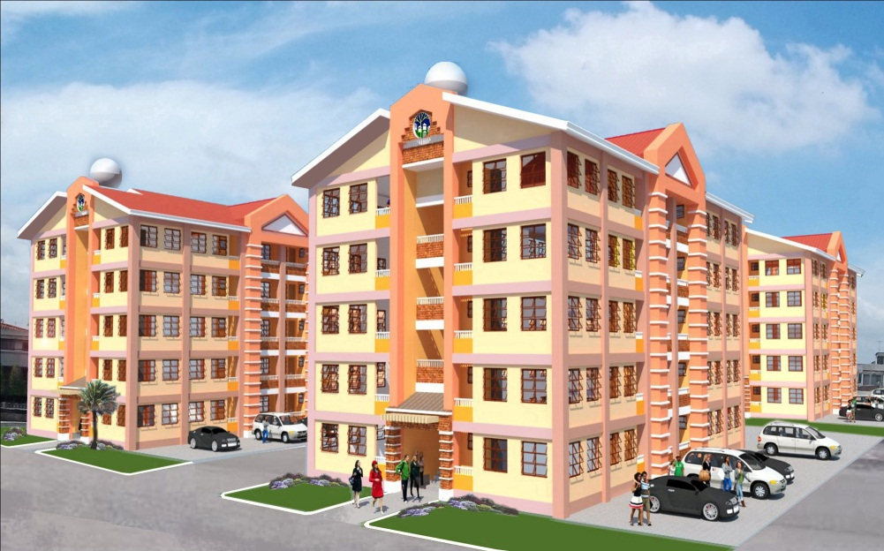
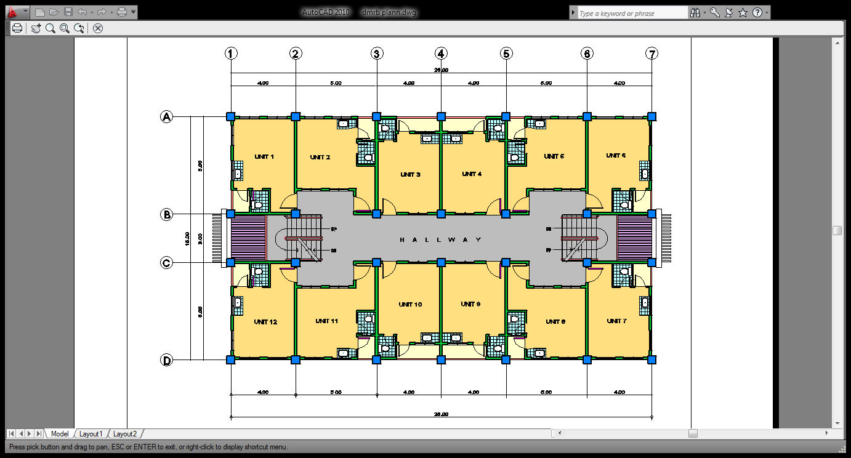
NHA LRB MODEL 1
GROUND FLOOR PLAN
PERSPECTIVE
TECHNICAL DATA
NO. OF STOREYS | FIVE (5)
TOTAL NO. OF UNITS PER BLDG. | 60
NO. OF UNITS PER FLOOR | 12
UNIT AREA | 24.00 sq.m.
TYPICAL SECOND TO FIFTH FLOOR PLAN

